Slide 1
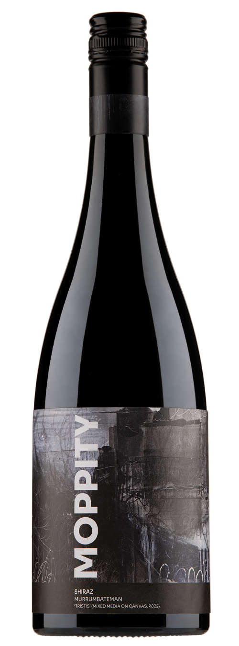
Moppity Vineyards “Tristis” Shiraz 2021
Variety & Clone: | Shiraz. (1127 and BVRC30 clones propagated from Moppity’s best Shiraz blocks in the Hilltops, used for Escalier and Reserve)
Region: | Canberra Region, Murrumbateman
Labelling notes: | The label for this wine was painted by the Canberra artist James Manning, a schoolfriend of winemaker Jason Brown.
Winemaking notes: | After a cool, long ripening growing season the fruit for Moppity’s first Canberra region Shiraz was handpicked, at 13 Baume. Processed into 1.5 tonne open fermenters with 30% whole-bunches, balance whole berries. Matured in 35% new French puncheons for 10 months.
Tasting notes
Colour: | Medium-deep red with a good tint of purple.
Nose: | Beautifully bright and fragrant aromas of red and blue berries, ripe cherries, black plums and hints of Asian spice.
Palate: | Medium bodied with a silky mouth feel. Red and blue berries dominate with aromatic floral notes and spice adding complexity. The finish is long with supple well integrated tannins.
Comments: | This is Moppity’s first Canberra Region Shiraz from the wineries new home on the Barton Highway in Murumbateman and is a great example of the regions ability to make world class, cool climate wines.
Wnemaker: | Jason Brown
Alcohol: | 13.5%
www.moppity.com.au T: 02 6382 6222 moppityvineyards @moppityvineyard

